Slide 1
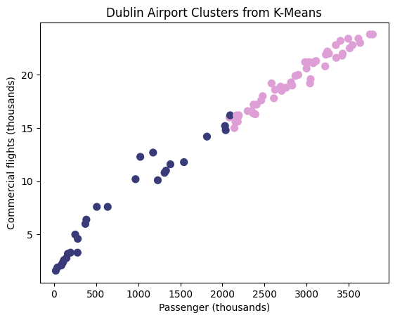
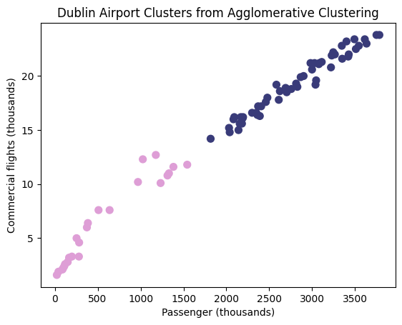
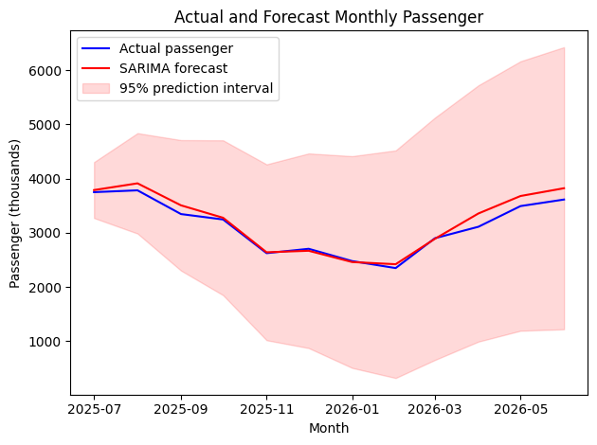
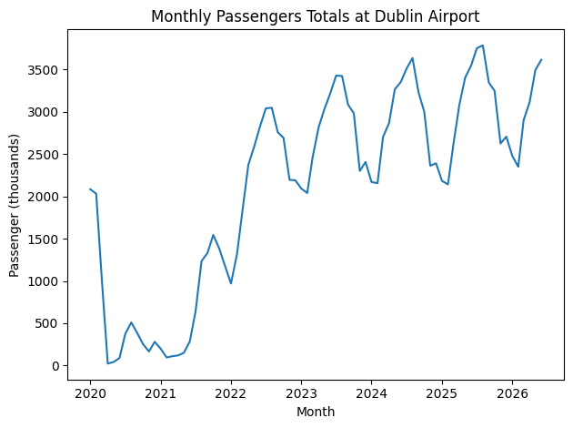


DUBLIN AIRPORT ACTIVITY ANALYSIS
Monthly clustering and passenger forecasting
Ricardo Cota | CCT College Dublin | Machine Learning for Business | CA1 Oct 2026
INTRODUCTION AND OBJECTIVES
METHODS
CONCLUSIONS
Dublin Airport supports Ireland’s trade, investment and tourism. Its operator links facilities and capacity planning to passenger demand (Dublin Airport, n.d.). This project examines monthly activity and evaluates passenger forecasts as potential support for airport planning.
K-Means and average-linkage agglomerative clustering use standardised passenger, freight and flight totals. Solutions with two to eight clusters are compared using Silhouette and Davies–Bouldin scores (scikit-learn developers, n.d.).
Clustering and forecasting provide complementary views of airport activity. Agglomerative clustering offers a modest advantage, while SARIMA outperforms the seasonal naïve benchmark during testing. Findings may inform planning, but do not directly estimate staffing or capacity needs. Future forecasting accuracy remains uncertain.
TIME SERIES MODELLING
RESEARCH QUESTIONS
SARIMA uses a 12-month seasonal period (statsmodels developers, n.d.). ADF tests, ACF/PACF and training AIC guide model selection. The first 66 months are used for training and the final 12 for testing. SARIMA (0,1,1)(0,1,0,12) achieved the lowest training AIC among the three candidates.
1. What groups of months have similar activity levels, and how do K-Means and agglomerative clustering compare?
2. How accurately does SARIMA forecast passengers compared with a seasonal naïve benchmark?
REFERENCES
Central Statistics Office (2026) TAM07 – Passengers, Freight and Commercial Flights. data.gov.ie/dataset/tam07-passengers-freight-and-commercial-flights (Accessed: 11 October 2026).
Dublin Airport (n.d.) About the Infrastructure Application (IA). dublinairport.com/corporate/airport-development/infrastructure-application/about
scikit-learn developers (n.d.) Clustering. scikit-learn.org/stable/modules/clustering.html
statsmodels developers (n.d.) SARIMAX. statsmodels.org/stable/generated/statsmodels.tsa.statespace.sarimax.SARIMAX.html
Dublin Airport, scikit-learn and statsmodels sources accessed: 18 October 2026
DATA PREPARATION
MODEL CHECKS AND LIMITATIONS
CSO table TAM07 provides passengers, freight and commercial flights (Central Statistics Office, 2026). The downloaded file contains 745,524 rows and eight columns.
Dublin records were filtered and reorganised into 78 monthly observations, January 2020–June 2026. Checks found no missing months or null measures. Aggregated categories were filtered to avoid double counting.
Residuals show no clear autocorrelation at lags 1–12, but an outlier and changing variability warrant caution. Correlated features and a single test period limit generalisation.
Lower/higher activity months:, K-Means: 28 / 50, Agglomerative: 24 / 54
CLUSTERING FINDINGS
FORECASTING FINDINGS
Both methods identify lower- and higher-activity months. Agglomerative clustering performs slightly better on both metrics for the two-cluster solutions. The groups describe activity levels and should not automatically be interpreted as recurring seasonal categories.
Monthly passenger totals: sharp decline, recovery and recurring fluctuations.
MAE and RMSE are expressed in thousands of passengers.

